Slide 1
Using Machine Learning to Find a Subset of Elements that can Determine the Mass of the Blackhole
Lara Kamal

Slide 2
Difficulty of Detecting IMBH
Optical:
Dust obscuration
BPT diagnostics not tested in IMBH regime
Broad lines associated with supernova activity
Low Metallicity
Active SF
Radio:
Indistinguishable from compact nuclear starbust
Noise from supernovae remnants, stars, gas/dust emission
Infrared:
Fails in galaxies where stellar luminosity overpowers AGN
Young starbursts can mimic AGN mid-IR colors
X-ray:
Compton thick
Ambiguity of source – XRBs, stellar populations
Notes:
It’s difficult to detect imbh in several wavelengths
For example,
In the radio range, there is noise from the supernovae remnant, stars, gas/dust emission
In the infrared, sometimes stellar luminosity overpowers the AGNs so they are difficult to detect

Slide 3
Accretion Disk
Accretion disk temperature, and peak wavelength emission, depend on black hole mass!
Notes:
From observing the accretion disk of the blackhole and looking at the peak wavelength emission, we can determine the mass of the blackhole

Slide 4
Simulated Spectra
Notes:
As you can see in this graph,

Slide 5
Diagnostic Line Ratios
M_{BH} < 10⁴ M☉
High ratios uniquely identify mid-range BH masses
High ratios uniquely identify low mass BHs
10⁴ M☉ < M_{BH} < 10⁶ M☉
Cann et al. 2018
Notes:
Jenna generated the data

Slide 6
Cloudy Model
Cloudy c17 (Ferland et al. 2017)
Input
Mass: Mass of the blackhole 100 – 10^{8.5} M☉
U: Ionization parameter 10⁻⁴ – 10⁻¹
Hden: Electron density n_{H} Log(n_{H}): 1.5 – 3.5
Output
Al9/Al8(3)
Ca8/Ca5(4)
Mg7(9)/Mg5(13)
Si11/Si9
…..
Fe13/Fe6(1.01)
3
55
Notes:
Jenna generated the data

Slide 7
Dataset
Mass of the BH
Ionization Parameters
n_{H}
Diagnostic Line Ratios

Slide 8
Dataset
Target/Class
Features/Attributes/Elements

Slide 9
Problem Statement
Given a set of elements, find a subset of elements that are the most sensitive to the mass of the blackhole
Notes:
Jenna generated the data

Slide 10
Feature Selection
A process used in machine learning to reduce the dimensions of the dataset. It selects a subset of relevant features to be used in model construction.
The dataset contains 55 different features
In this effort, I used two types of feature selection methods, Univariate Selection and Recursive Feature Elimination

Slide 11
Univariate Selection
Univariate Selection was used along with Random Forest Classifier
The scikit-learn library provides the SelectKBest class, which can be used with a suite of different statistical tests to select a specific number of features.
Chi-squared test to determine the features (such as Si7(6)/Si6, Na6(14)/Na3, etc) that have the strongest relationships with the target (Mass of blackhole).
Ranked the features based on the output of the chi-squared test.
This method does not necessarily give the subset of the different elements, but it ranks them based on their importance.
Notes:
The scikit-learn library provides the SelectKBest class, which can be used with a suite of different statistical tests to select a specific number of features. I used chi-squared test to determine the features (such as Si7(6)/Si6, Na6(14)/Na3, etc) that have the strongest relationships with the output variable (Mass of blackhole). Then, I ranked the features based on the output of the chi-squared test. This method does not necessarily give you the subset of the different element, but it ranks them based on their importance.
Statistical tests can be used to select those features that have the strongest relationships with the output variable. The scikit-learn library provides the SelectKBest class, which can be used with a suite of different statistical tests to select a specific number of features. The following example uses the chi squared (chi^2) statistical test for non-negative features to select K best features from the data. The Chi Square statistic is commonly used for testing relationships between categorical variables. The null hypothesis of the Chi-Square test is that no relationship exists on the categorical variables in the population; they are independent.
Chi-squared method does the following:
Null hypothesis: Give each feature equal probability (Expected probability)
Sample the instances and find the probability that a feature appears given the class (mass of the blackhole)
If the probability exceeds a threshold, then reject the null hypothesis and apply chi-squared
X-squared = sum (actual - expected)^2/expected for all of the sample

Slide 12
Result
Scores:
Accuracy: 23.0 %
Precision: 43.6
Recall: 23.0
F1 score: 23.0
The model did not perform well

Slide 13
Recursive Feature Elimination
I used logistic regression algorithm, which uses the sigmoid function, to select top K features (I chose 10)
RFE recursively removes the features and builds a model on the features that remain.
It uses model accuracy to identify which features (such as Si7(6)/Si6, Na6(14)/Na3, etc) contribute the most to predicting the target (Mass of blackhole).

Slide 14
Result
Scores:
Accuracy: 26.3 %
Precision: 46.7
Recall: 26.3
F1 score: 28.0
The model did not perform well

Slide 15
Linear Regression
I used a regression model between every attribute and the target (Mass of the blackhole)
I used a second regression model between every attribute and U (ionization parameter)
I divided the mass of the blackhole into three bins:
Low Mass = Less than 10000
Medium Mass = 10000 - 1000000
High Mass = greater than 1000000

Slide 16
Regression Scores
Score = |M_{slope}| – M_{SSE} – |U_{slope}| – U_{SSE}
M_{slope} = Slope of the line for the mass of the blackhole
M_{SSE} = Sum Square Error for the mass of the blackhole
U_{slope} = Slope of the line for the U parameter
U_{SSE} = Sum Square Error for the mass of the ionization parameter
The goal is to maximize the score

Slide 17
Mass Plots

Slide 18
U Parameter Plots

Slide 19
Result
Low Mass AGNs | Medium Mass AGNs | High Mass AGNs
['Si10/Si9', 38.253009333776255] | ['Si10/Si9', 10.361250042213534] | ['Si10/Si6', 46.486155855284053]
['Si11/Si6', 1.9999569610401438] | ['Na6(8)/Na4', -20.986948087745638] | ['Fe13/Fe6(1.01)', -29.739718424470876]
['Al6(9)/Al5', -6.5692722126659842] | ['Al6(9)/Al5', -21.577457393116937] | ['Al8(3)/Al6(3)', -32.976050935902308]
['Al9/Al8(5)', -6.8902930509826845] | ['Ne6/Ne5(14)', -21.955151609736454] | ['Ne6/Ne5(14)', -51.319484861800845]
['Si10/Si7(2)', -6.9605909814656606] | ['Ne6/Ne5(24)', -22.008674470009549] | ['Al6(9)/Al5', -51.513930334546565]
['Na6(8)/Na4', -7.1132591855712439] | ['Si10/Si7(2)', -22.131740957368667] | ['Ne6/Ne5(24)', -51.544640662811091]
['Al9/Al8(3)', -7.25089995421878] | ['Si7(6)/Si6', -24.446315349390979] | ['Mg7(9)/Mg5(13)', -51.716358338258424]
['Mg5(13)/Mg4', -7.6676882695852955] | ['Mg5(13)/Mg4', -24.447729856036805] | ['Al9/Al6(9)', -51.866888249045815]
['Al9/Al6(3)', -7.9162313295068323] | ['Na7/Na6(8)', -24.791285888682914] | ['Al8(5)/Al6(3)', -52.457901541590928]
['Ne6/Ne5(24)', -7.9261392805508954] | ['Al9/Al8(3)', -24.853272223516175] | ['Mg5(13)/Mg4', -52.458845616826686]
['Ne6/Ne5(14)', -8.1161162726307214] | ['Al8(3)/Al6(3)', -24.935907322445303] | ['Na6(8)/Na4', -52.769580905141225]
['Na7/Na6(14)', -8.1231324268968663] | ['Al9/Al8(5)', -25.406310424515546] | ['Mg5(5)/Mg4', -53.175981461472546]

Slide 20
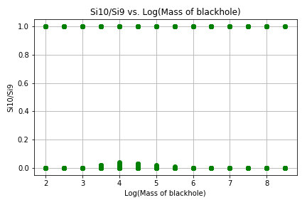
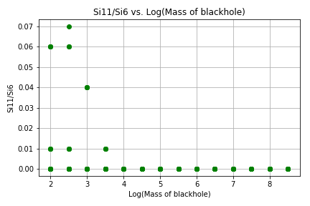
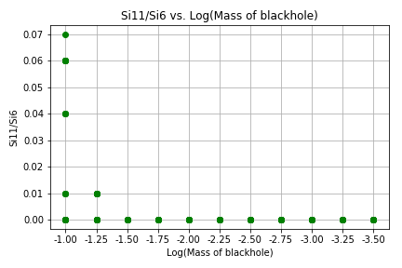
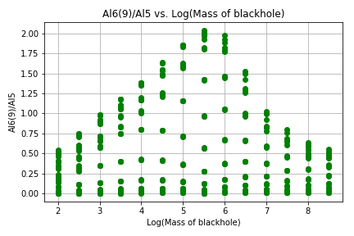
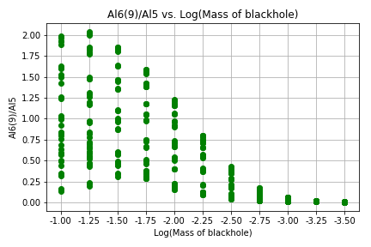
Low Mass Plots
Score = 38.25
Score = 1.99
Score = -6.5

Slide 21
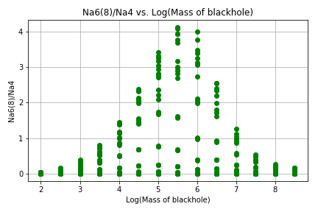
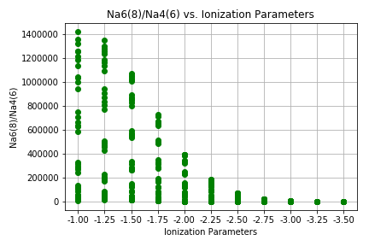
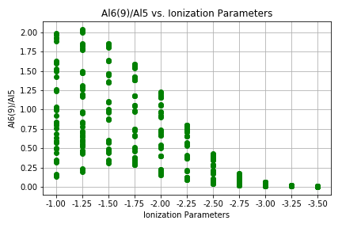
Intermediate Mass Plots
Score = 10.3
Score = -20.98
Score = -21.57

Slide 22
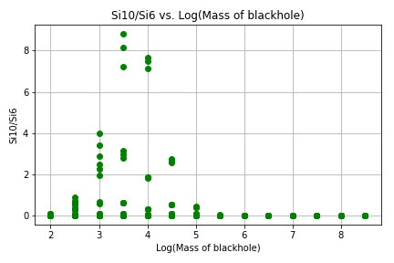
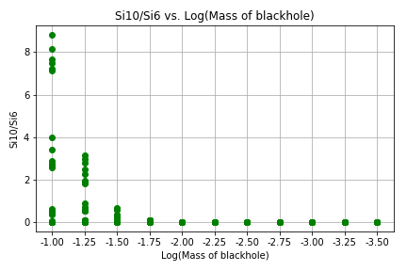
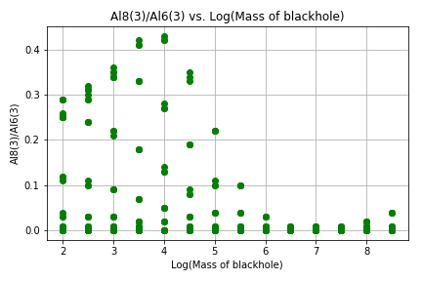
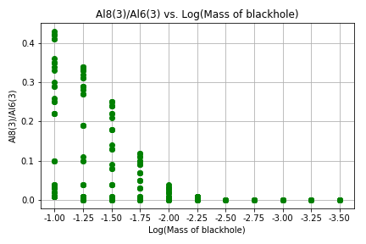
High Mass Plots
Score = 46.4
Score = -29.7
Score = -32.9

Slide 23
Results
Only useful for low mass AGNs

Slide 24
Neural Network
51 nodes(relu) 15 nodes(tanh) 1 node

Slide 25
Activation Functions

Slide 26
Building the Model
Normalization: z-score
Between: -1 to 1
Data cleaning
Missing data
Keras Regressor
Iterations = 15000 to update the weight

Slide 27
Results
Scores:
Mean Square Error = 0.84
Less than an order of magnitude
How to Improve?
More Data (next week)
More parameter tuning

Slide 28
Conclusion
Classification with feature selection:
Simple to create and tune
Low accuracy
Linear Regression
Complicated
Only works on low mass AGNs
Neural Network with Keras Regressor
Time intensive
Requires large dataset
Accurately predicts the low, medium, and high blackhole masses within less than an order of magnitude

